Slide 1
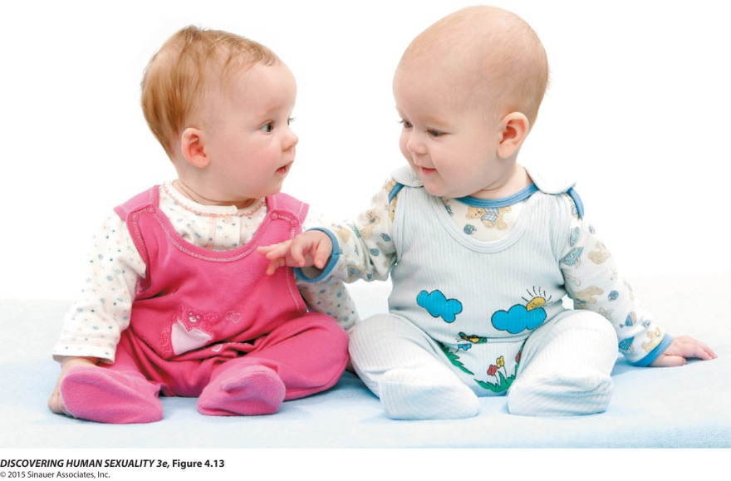
Sex, Gender, and Transgender

Slide 2
Chapter 4: Sex, Gender, and Transgender
  Genes and Hormones Guide Sex Development
  Sex Development May Go Awry
  Gender Is a Central Aspect of Personhood
  There Are Many Sex Differences in Sexuality
  Biological Factors Influence Gender
  Life Experiences Influence Gender
  Gender Development Is Interactive
  Transgender People Cross Society’s Deepest Divide

Slide 3
Genes and Hormones Guide Sex Development
Sex chromosomes determine the development of an embryo:
  An embryo with two X chromosomes develops as a female.
  An embryo with one Y chromosome and one X chromosome develops as a male.
The sex-determining gene, called SRY, is located on the Y chromosome.
Its presence directs sexual development along the male pathway.

Slide 4
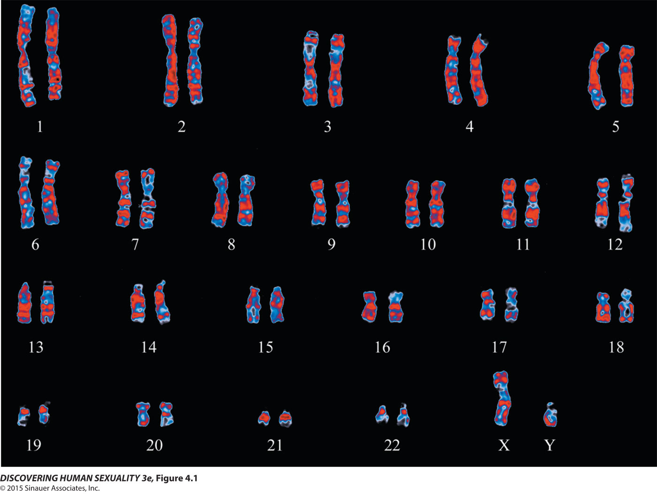
Figure 4.1 Human chromosomes

Slide 5
Genes and Hormones Guide Sex Development
Female and male embryos possess both Wolffian and Müllerian ducts.
  Wolffian ducts are precursors of the male reproductive tract.
  Müllerian ducts are precursors of the female reproductive tract.

Slide 6
Genes and Hormones Guide Sex Development
In males, testes produce anti-Müllerian hormone (AMH), which causes the female ducts to regress, and testosterone, which stimulates the Wolffian ducts to produce male internal organs.
In females, the absence of AMH allows Müllerian ducts to persist and develop into the oviducts, uterus, and deeper parts of the vagina.

Slide 7
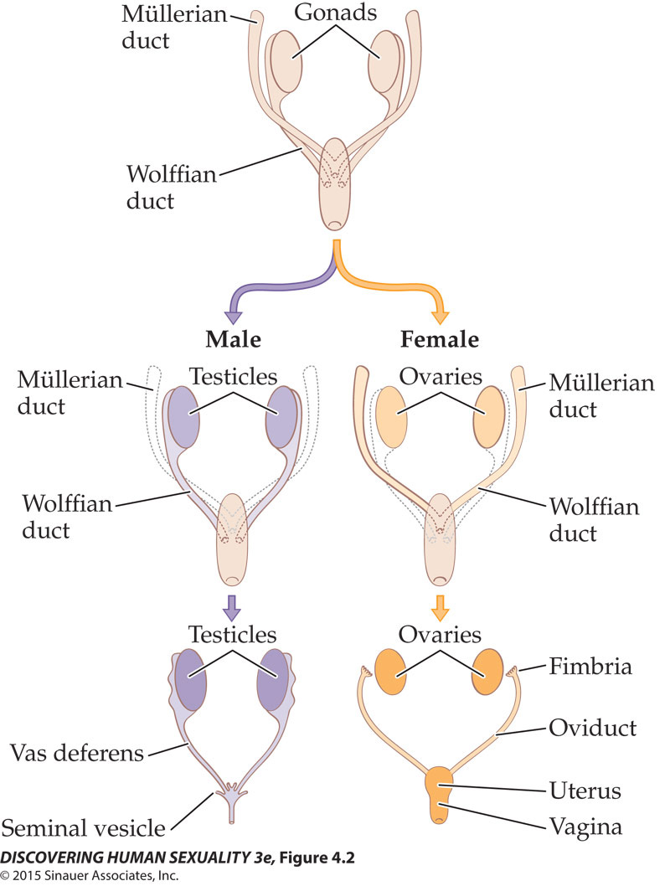
Figure 4.2 Development of the male and female reproductive tracts

Slide 8
Genes and Hormones Guide Sex Development
Female and male external genitalia develop from the same precursors.
Each embryo has a slit, the cloaca, which is covered by a membrane.
The cloaca is flanked by two urethral folds and, outside those, the genital swelling.
At the middle of the front end of the cloaca is the genital tubercle.

Slide 9
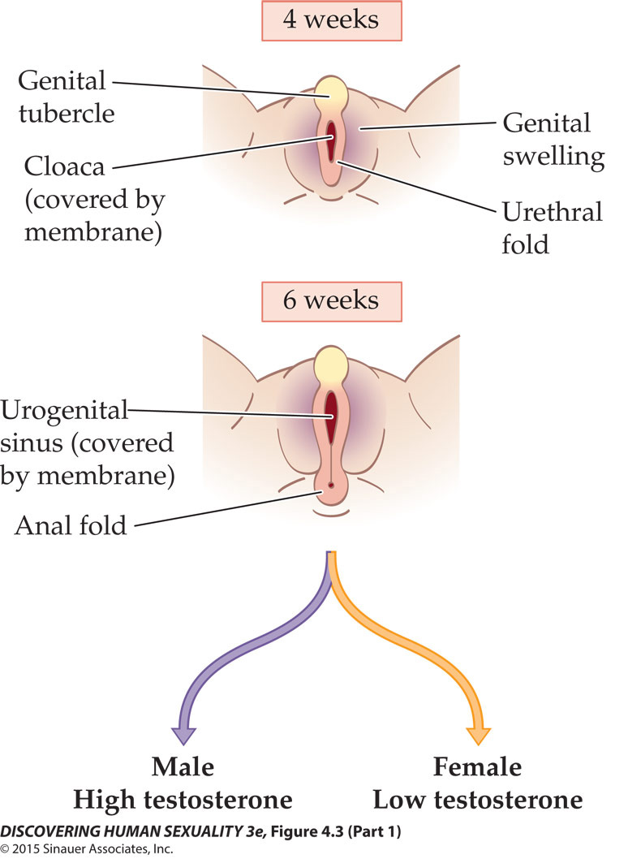
Figure 4.3 Development of the male and female external genitalia (Part 1)

Slide 10
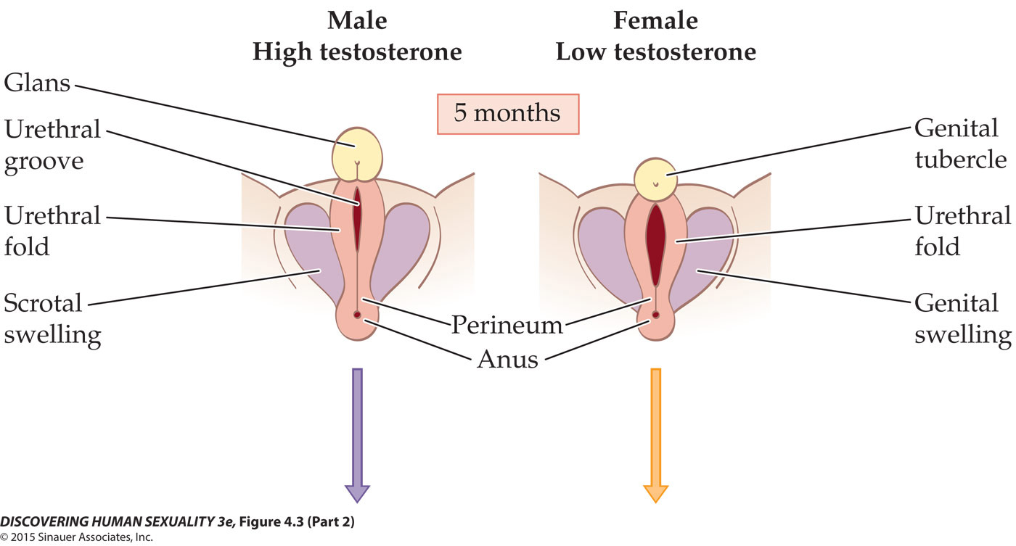
Figure 4.3 Development of the male and female external genitalia (Part 2)

Slide 11
Genes and Hormones Guide Sex Development
The urethral folds become
  Inner labia in females
  Shaft of the penis in males
The genital swellings give rise to
  Outer labia in females
  Scrotum in males

Slide 12
Genes and Hormones Guide Sex Development
The genital tubercle forms
  External portion of clitoris in females
  Glans of the peinis in males
In the absence of SRY and testosterone, female external genitalia develop—the default.

Slide 13
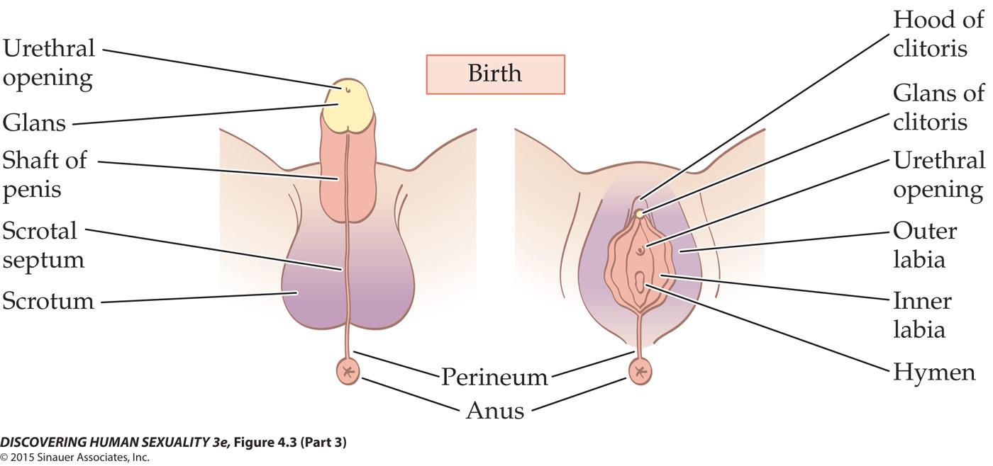
Figure 4.3 Development of the male and female external genitalia (Part 3)

Slide 14
Genes and Hormones Guide Sex Development
In both sexes, the gonads begin near the kidneys and descend as development progresses.
By 10 weeks, the gonads are near the top of the pelvis.
  In females, they stay here until birth.
  In males, the gonads continue to descend. Shortly before birth, they reach the scrotum.

Slide 15
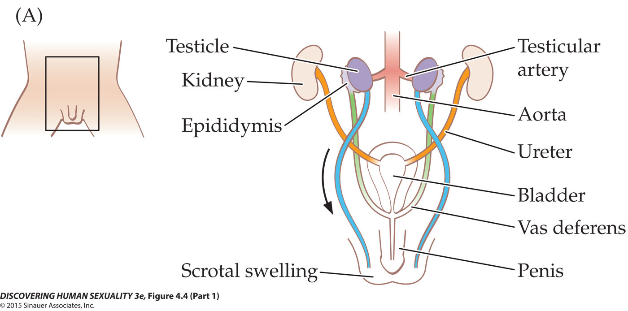
Figure 4.4 Descent of the testicles (Part 1)

Slide 16
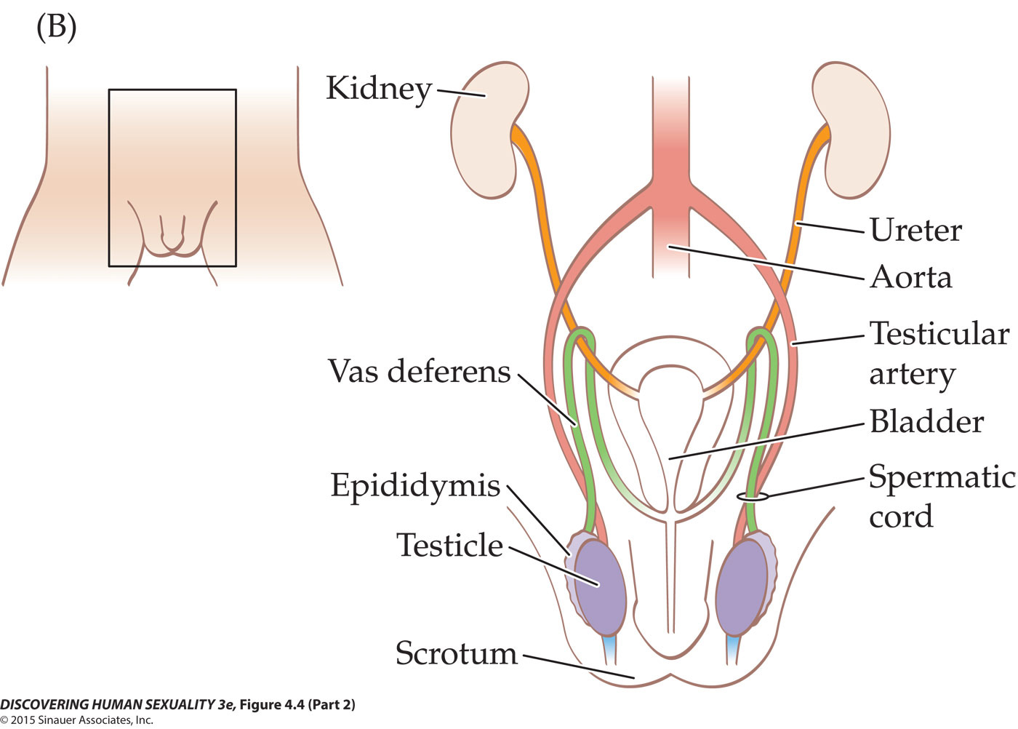
Figure 4.4 Descent of the testicles (Part 2)

Slide 17
Genes and Hormones Guide Sex Development
In 2% to 5% of newborn boys, one or both testicles have not descended into the scrotum.
  Testicles usually arrive within a few weeks of birth.
  If testicles have not arrived by 3 months, the condition is called cryptorchidism and must be surgically moved.
    Increased risk of cancer

Slide 18
Genes and Hormones Guide Sex Development
There are differences in brain structure, function, and chemistry between the two sexes.
  Men’s brains are about 10% larger—proportionate to overall body size difference.
  Connections between left and right hemispheres are stronger in women; connections within each side of the brain are stronger in men.

Slide 19
Genes and Hormones Guide Sex Development
  Men use their right amygdala more, and women use their left amygdala more.
  Men’s brains produce 52% more serotonin than women’s brains.
  Women’s brains produce much more dopamine than men’s brains.
These differences are attributed to the different levels in circulating androgen levels between females and males during development.

Slide 20
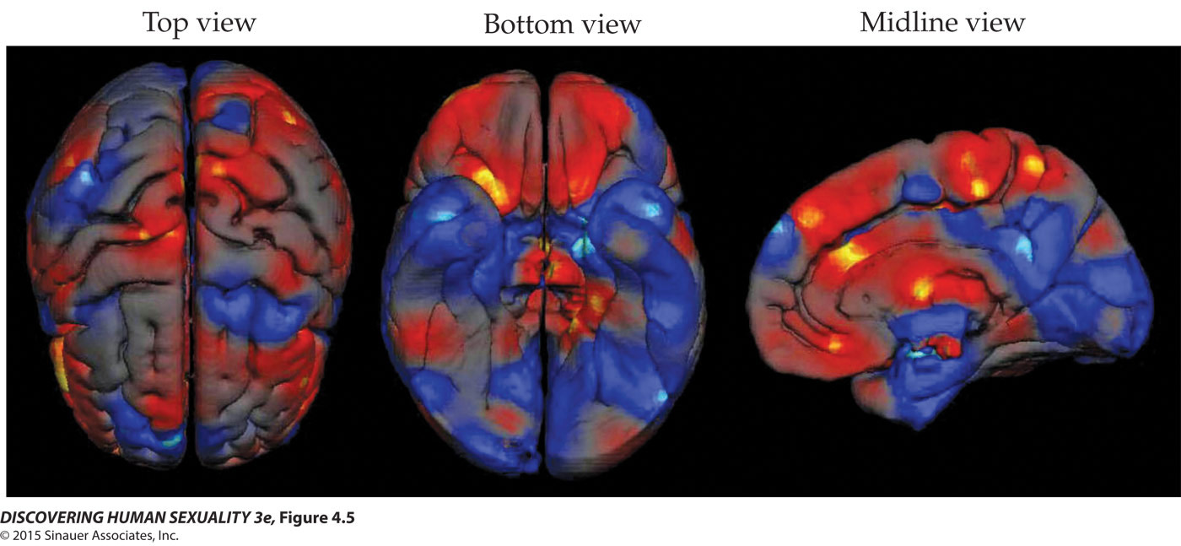
Figure 4.5 Sex differences in the cerebral cortex

Slide 21
Sex Development May Go Awry
Chromosomal anomalies affect growth and fertility.
  Klinefelter syndrome (XXY, XXXY): male, tall, low testosterone, small genitals, low sperm count
  Turner syndrome (XO): female, short, lack normal ovaries, require assistance to enter puberty
  XYY syndrome: male, may have genital anomalies, atypical cerebral cortex development
  Triple-X syndrome: female, mild cognitive deficits, low fertility

Slide 22
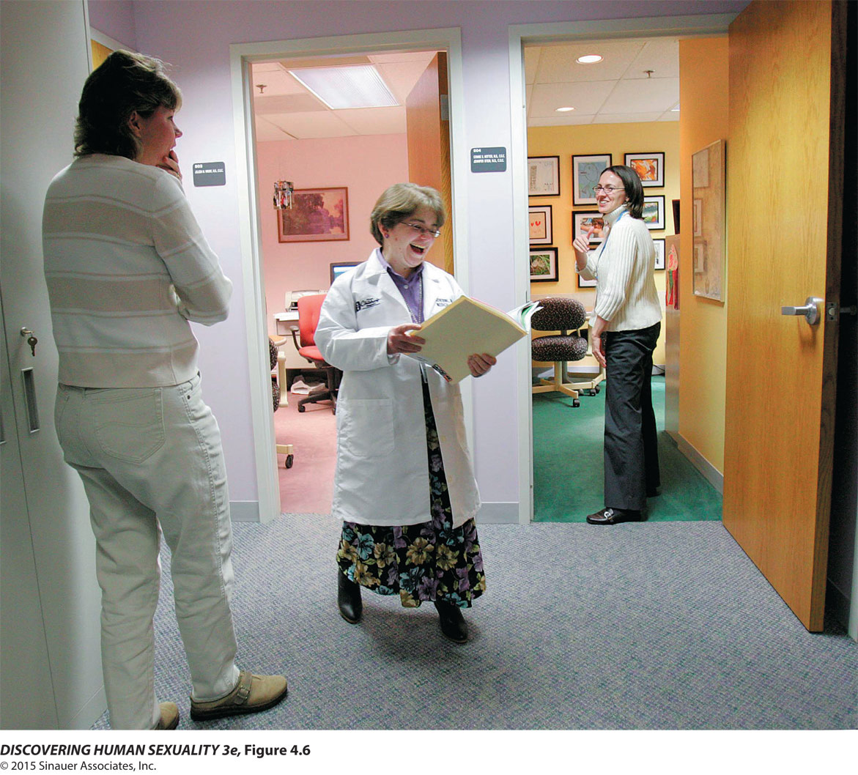
Figure 4.6 Turner syndrome

Slide 23
Sex Development May Go Awry
The gonads or genitals may be sexually ambiguous.
  Gonadal intersexuality: possession of ovarian and testicular tissue, most look like women, usually infertile
  Congenital adrenal hyperplasia (CAH): XY “females,” lack reproductive tract, shallow vagina, infertile
  Androgen Insensitivity Syndrome (AIS): XX fetus that experienced large amounts of androgens, partial masculinization of genitals

Slide 24
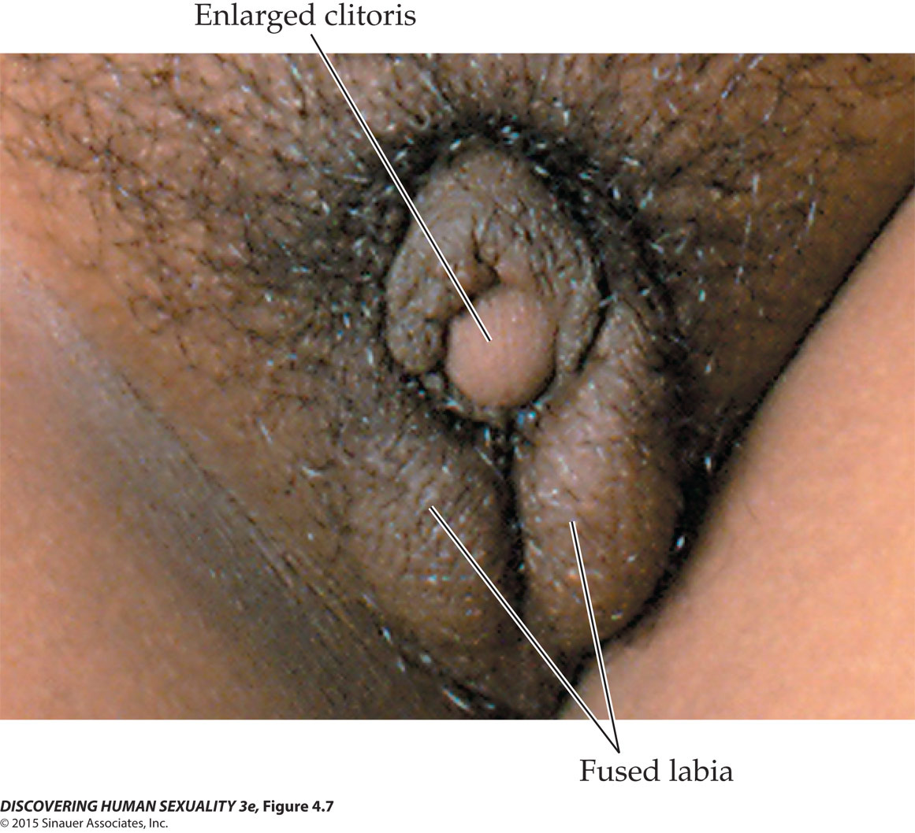
Figure 4.7 Partial masculinization of genitalia

Slide 25
Gender Is a Central Aspect of Personhood
Gender identity is the personal sense of which sex one belongs to. For some people, gender identity does not match their anatomical sex.
Gender identity is expressed via gender role behavior: clothing choices, walk, talk, etc.
Sexual orientation, cognition, and personality traits differ between men and women.
Differences in sexuality include attitudes toward casual sex, jealousy, and frequency of masturbation.

Slide 26
Gender Is a Central Aspect of Personhood
Cognitive differences between sexes vary, but less so than physical differences, such as average height.
Men tend to score higher than women on verbal and physical aggression evaluations.
Women’s interests tend to be more people related and empathetic; men’s interests tend to be more related to things.

Slide 27
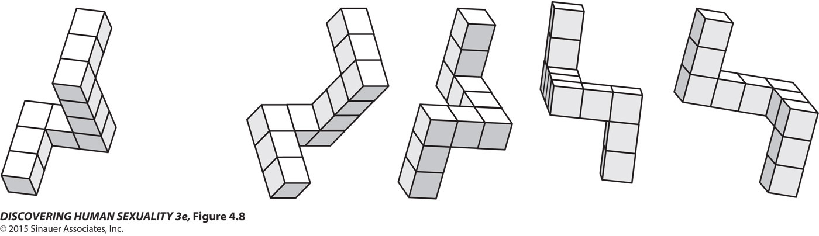
Figure 4.8 Mental rotation task

Slide 28
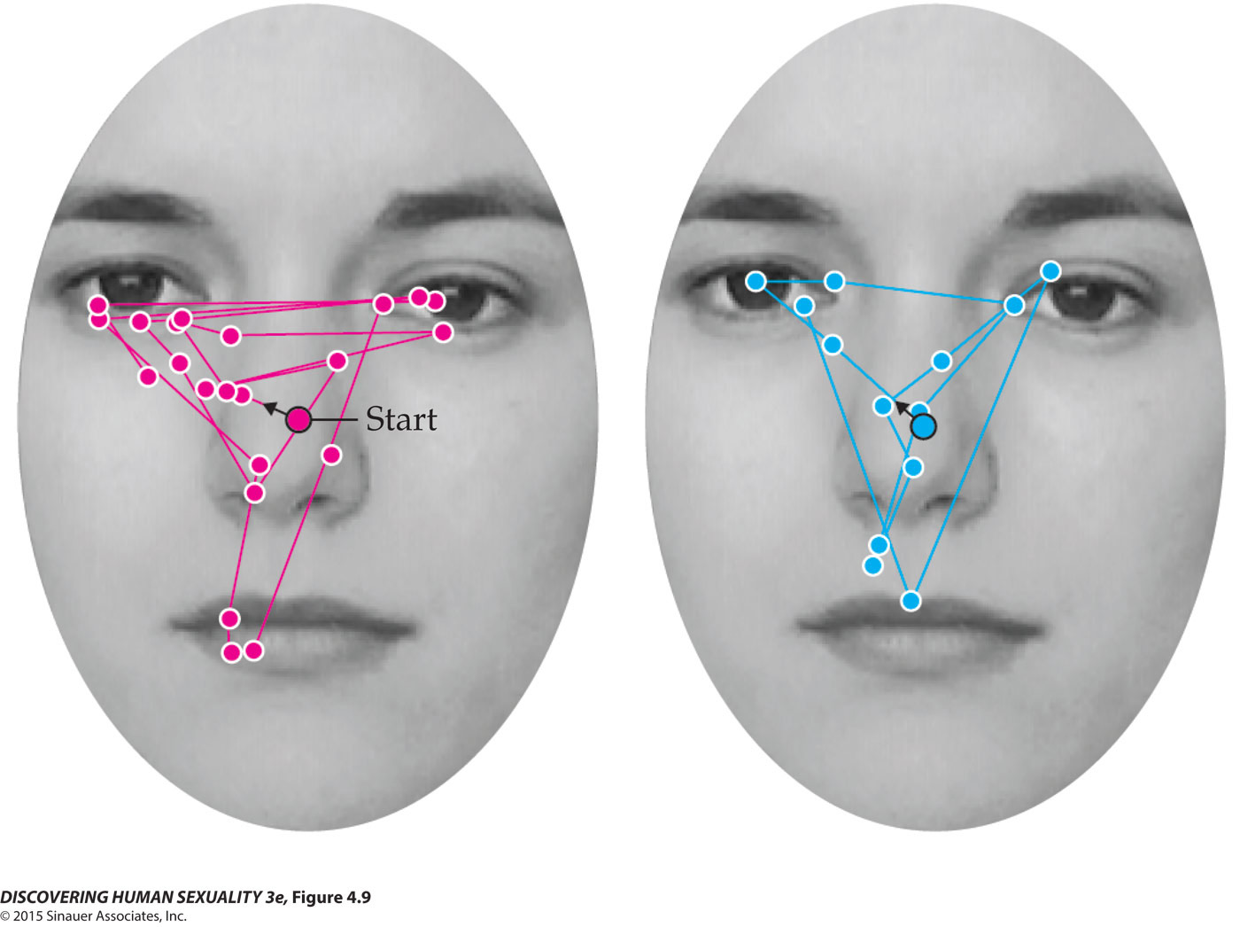
Figure 4.9 Female superiority in face recognition

Slide 29
Gender Is a Central Aspect of Personhood
Sexuality differences
  Men have a stronger sex drive.
  Men express more permissive attitudes toward casual sex.
  Women are typically attracted to older partners, and men to younger ones.
  Men are more concerned than women with physical attractiveness of partner.

Slide 30
Gender Is a Central Aspect of Personhood
Sexuality differences
  Women are more likely to experience emotional jealousy, and men sexual jealousy.
  Men are more likely to engage in unusual forms of sexual expression.
  Women are less likely to pay for sex and more likely to receive money for sex.
  Women and men have different sexual response cycles.

Slide 31
Gender Is a Central Aspect of Personhood
Many gender differences arise at a young age:
  Male fetuses are more active than female fetuses.
  By about 3 months of age, most children show sex differences in toy preferences.
  By about 4 years of age, most boys prefer to play with boys, and most girls with girls.
  Girls play is more governed by social conventions, and boys by principles of justice.

Slide 32
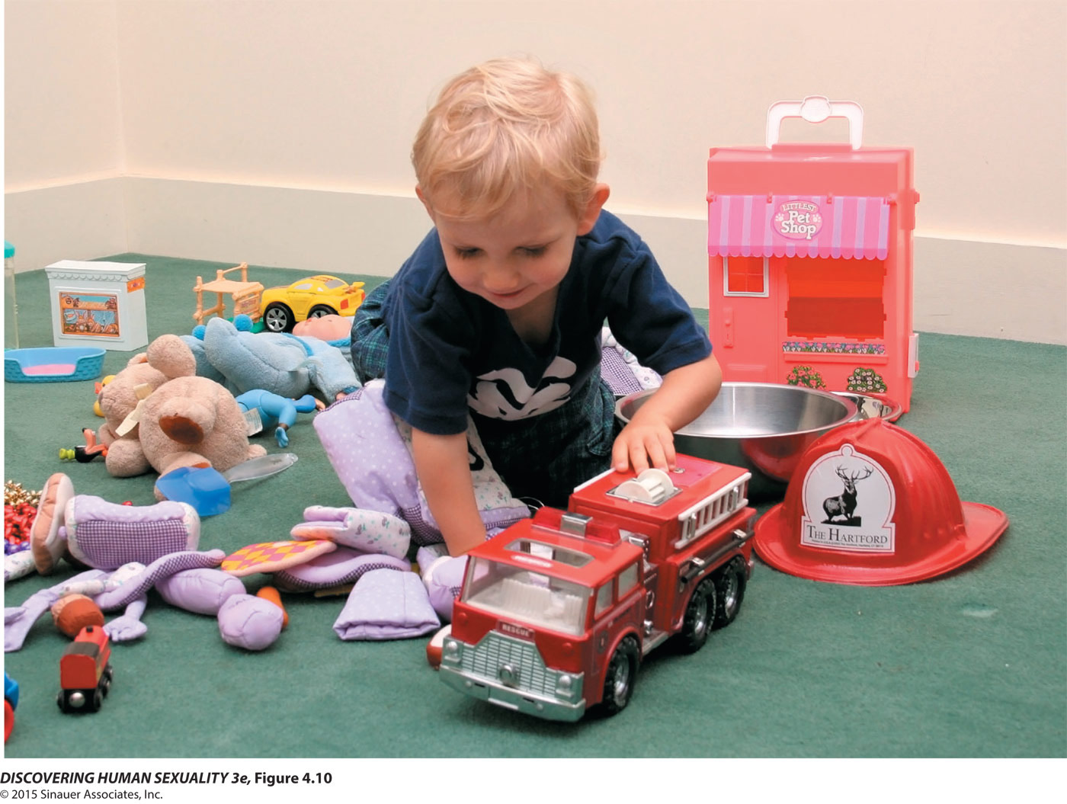
Figure 4.10 Toy preference test

Slide 33
Biological Factors Influence Gender
Evolutionary factors influence gender development:
  Casual sex is less costly for men than women.
  Jealousy—no certainty of which man fathered a particular child

Slide 34
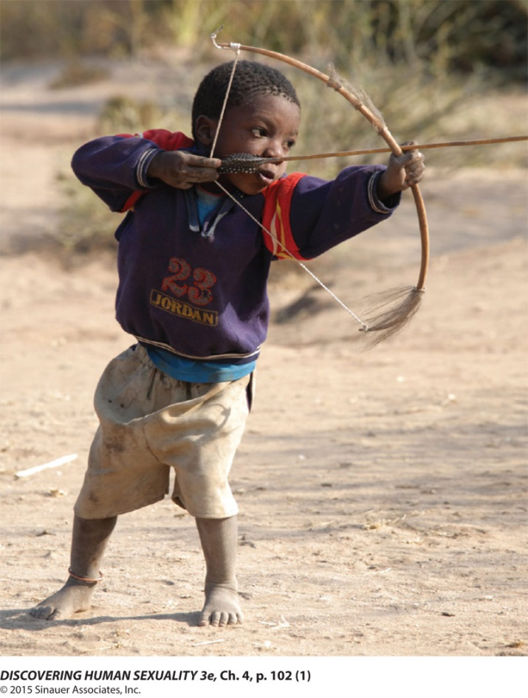
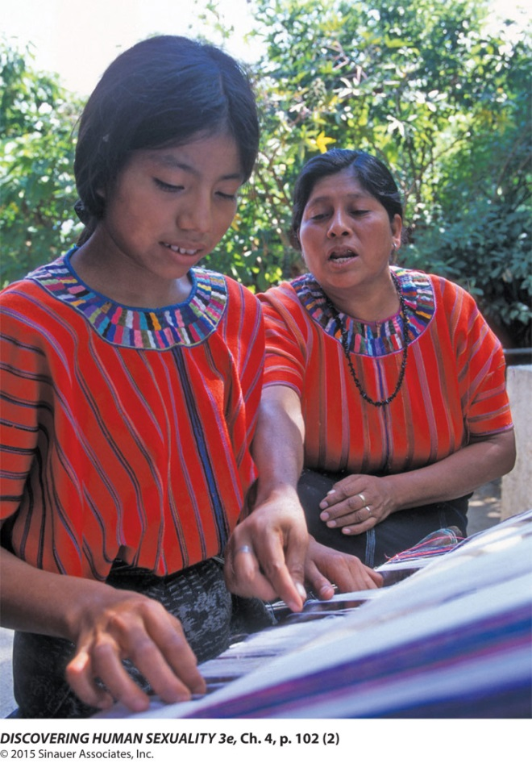
Biological Factors Influence Gender
  Cognitive differences may be due to long-standing division of labor between men and women.

Slide 35
Biological Factors Influence Gender
In girls with CAH, some, but not all, behavioral traits are shifted in the masculine direction.
Higher prenatal androgen levels shift behaviors of girls and boys in the masculine direction.
The lower the levels of fetal testosterone in girls, the stronger her preference for “girl toys” when she is 3 years old.

Slide 36
Biological Factors Influence Gender
The ratio of the index-finger length to the ring-finger length is an anatomical marker in adults that may reflect the degree to which people were exposed to testosterone prenatally.
The 2D:4D ratio correlates with many gendered characteristics.

Slide 37
Life Experiences Influence Gender
Life experiences influence gender development beginning early in life:
  Observing socialization
  Rewards and punishments
  Imitation
  Language
  Gender learning from advice

Slide 38

Figure 4.13 Babies enter a gendered world

Slide 39
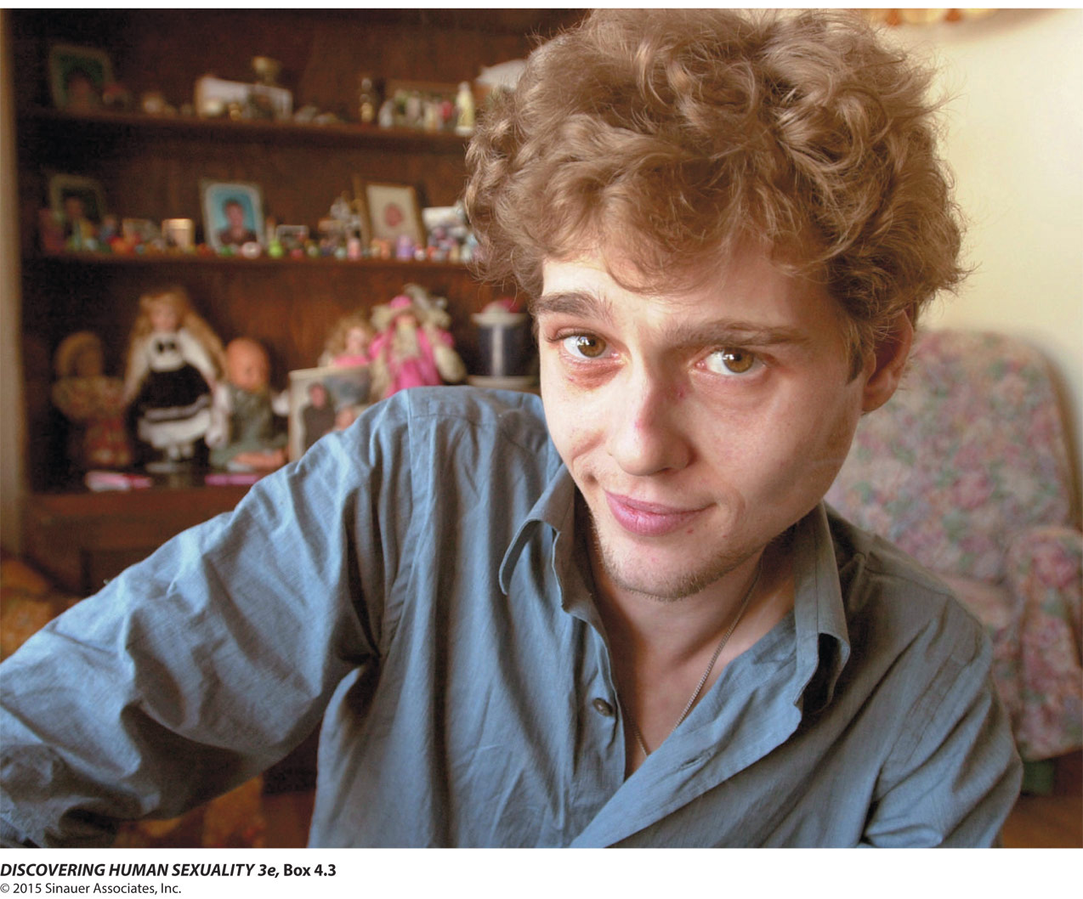
Box 4.3 Personal Points of View: The Boy Who Was Raised as a Girl

Slide 40
Life Experiences Influence Gender
Cognitive models focus on thought processes
  Sexual script theory

Slide 41
Transgendered People Cross Society’s Deepest Divide
Gender development is interactive.
Transgender people cross society’s deepest divide.
Trans men and women have probably existed in all human societies.

Slide 42
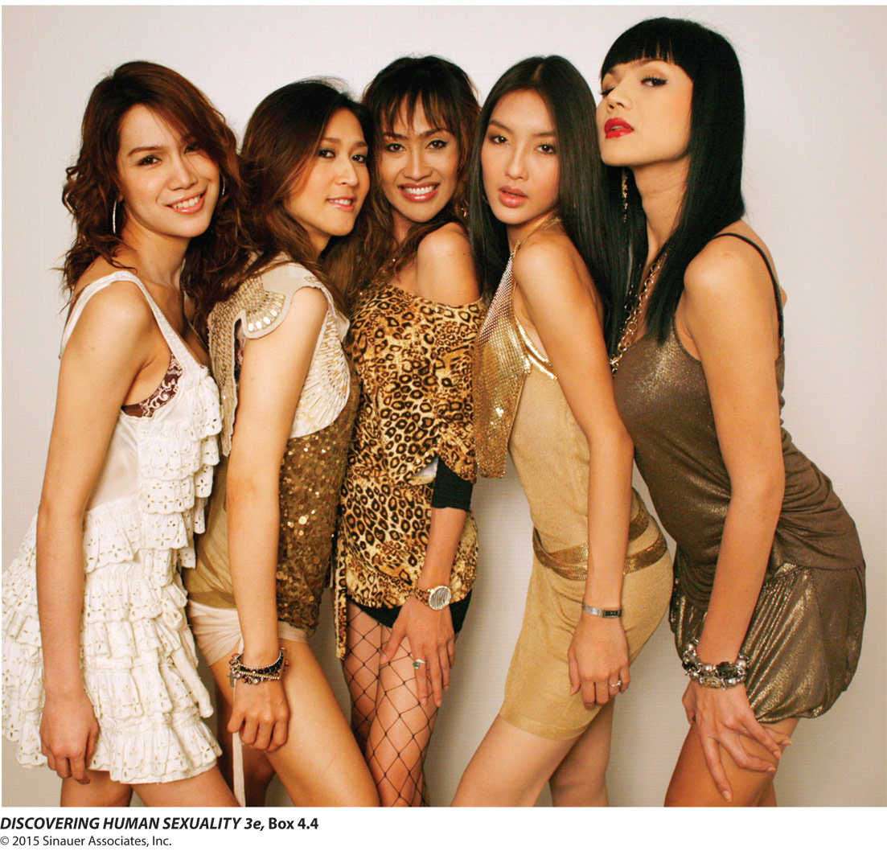
Box 4.4 Cultural Diversity: Trans Men and Women in Cross-Cultural Perspective

Slide 43
Transgendered People Cross Society’s Deepest Divide
Transexual individuals are of more than one kind.
  F-to-M transexuals (trans men)
  M-to-F transexuals (trans women)
  Transvestism
  Autogynephilia

Slide 44
Transgendered People Cross Society’s Deepest Divide
Transexual is the term generally used for transgender individuals who seek to medically change their body to the other sex.
Sex-reassignment, transitioning, is a multistage process.
  Psychological and physical evaluation
  Real-life experience
  Hormone treatment
  Sex-reassignment surgery

Slide 45
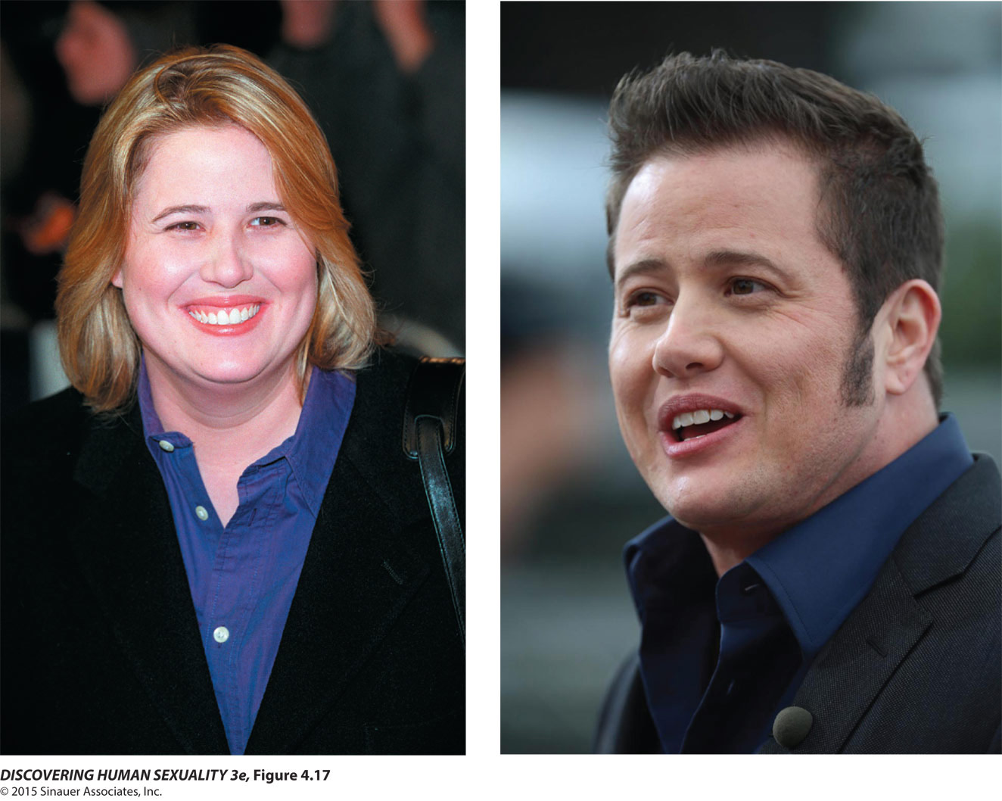
Figure 4.17 Chastity Bono (left), transitioned to Chaz Bono (right) between 2008 and 2010

Slide 46
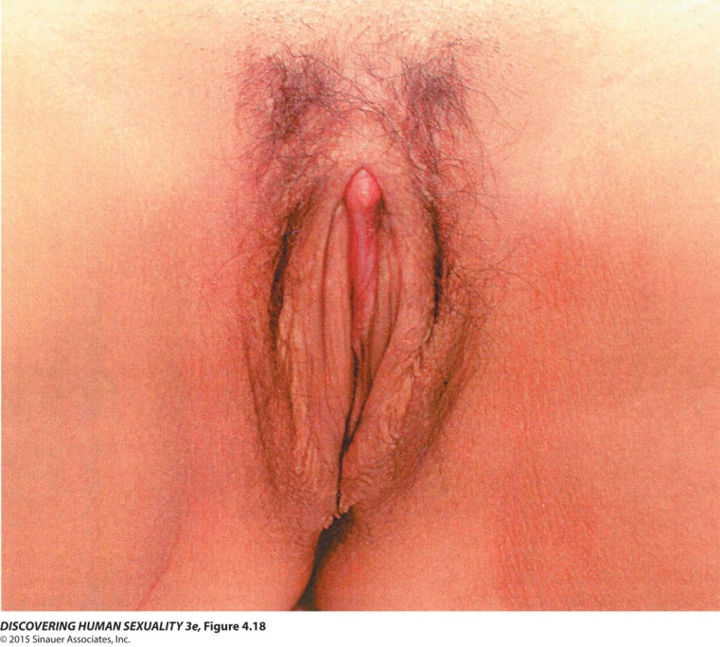
Transgendered People Cross Society’s Deepest Divide
For transexual women, key surgical procedures include:
  Removing penis and testicles
  Constructing vagina, labia, and clitoris
  Breast augmentation

Slide 47
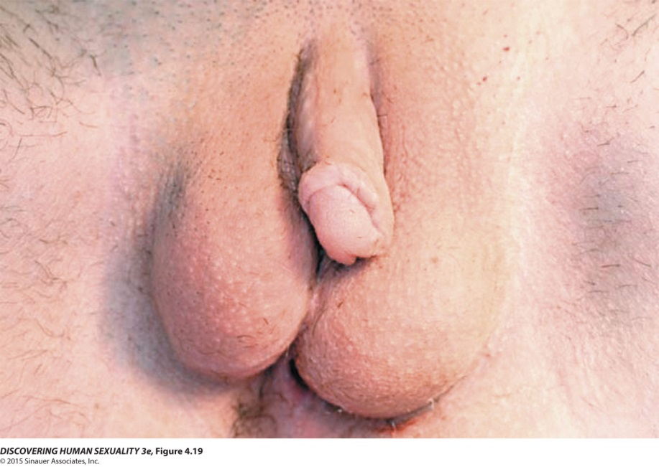
Transgendered People Cross Society’s Deepest Divide
For transexual men, key surgical procedures include:
  Removing ovaries, uterus, and vagina
  Constructing scrotum and penis
  Removal of breasts

Slide 48
Transgendered People Cross Society’s Deepest Divide
Age at time of medical treatment seems very important, so some centers are now treating children at or before puberty.

Slide 49
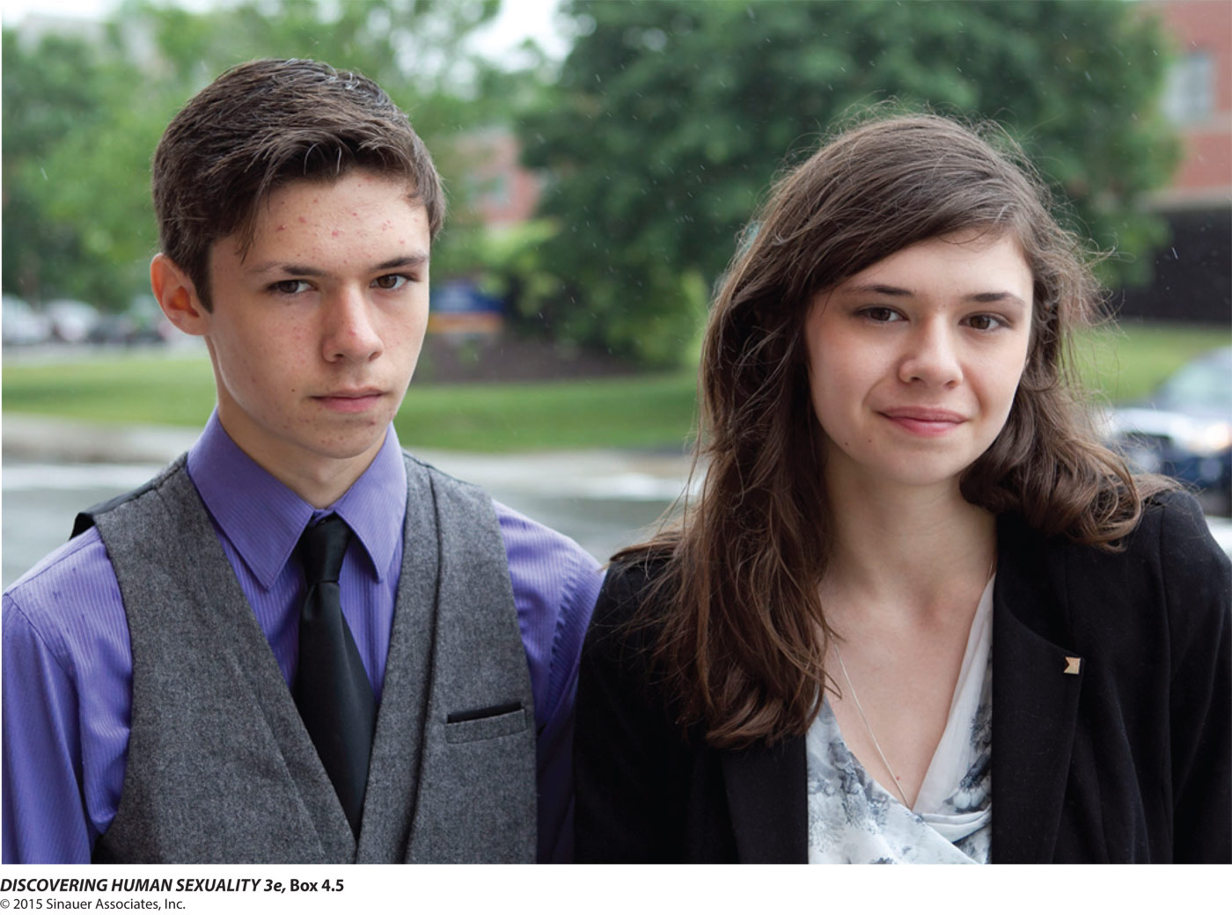
Box 4.5 Controversies: How Should We Treat Gender-Dysphoric Children?

Slide 50
Transgendered People Cross Society’s Deepest Divide
Some transgender people do not want surgery.
  Contradiction of inner and outer life may not bother them.
  Medical route may not be affordable.
  Less than ideal results may not be worth it.
  Cross-dressing, passing as other sex, may be satisfactory.
  Freedom to switch roles may valuable.
  Not passing as opposite sex may provide satisfaction.

Slide 51
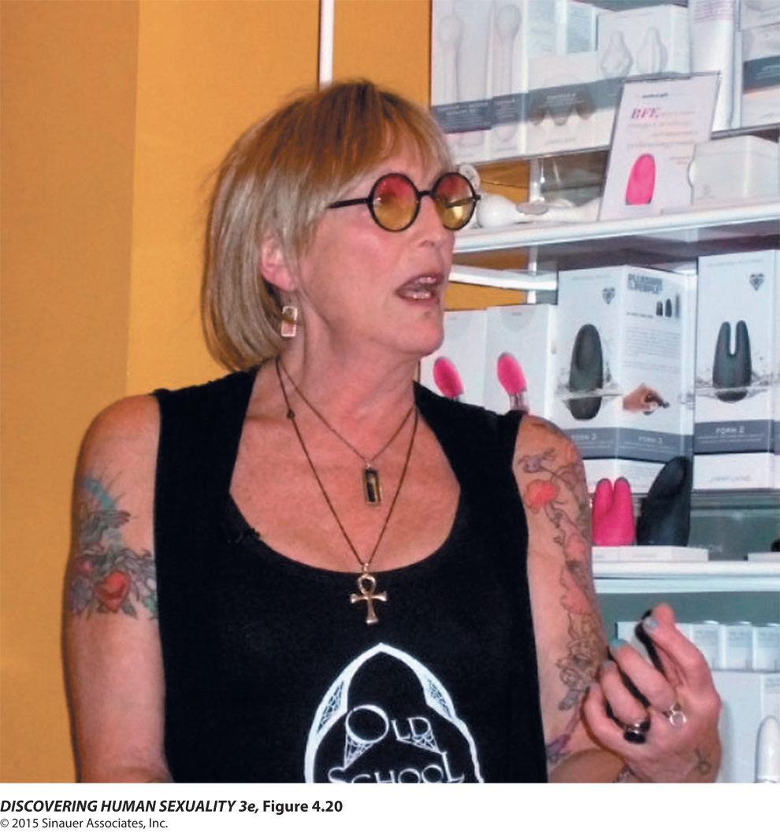
Figure 4.20 Kate Bornstein

Slide 52
Transgendered People Cross Society’s Deepest Divide
Trans people struggle for awareness and acceptance. Trans people
  Are relatively few in number
  Work to clarify their unique identity
  Are at greater risk of violence and discrimination
Transphobia: Hatred of transgender people

Slide 53

Figure 4.21 Transgender teen

